Slide 1
Fundamentals of Software Engineering
LECTURE 12:ACTIVITY DIAGRAM

Slide 2
What is an Activity Diagram in UML?
Is basically a flowchart to represent the flow from one activity to another activity.
The activity can be described as an operation of the system.
The basic purpose of activity diagrams is to capture the dynamic behavior of the system.
It is also called object-oriented flowchart.

Slide 3
What is an Activity Diagram in UML
We use Activity Diagrams to illustrate the flow of control in a system and refer to the steps involved in the execution of a use case.
We model sequential and concurrent activities using activity diagrams. So, we basically depict workflows visually using an activity diagram.
An activity diagram focuses on condition of flow and the sequence in which it happens.
We describe or depict what causes a particular event using an activity diagram.

Slide 4
Uses of an Activity Diagram
Dynamic modeling of the system or a process.
Illustrate the various steps involved in a UML use case.
Model software elements like methods, operations and functions.
We can use Activity diagrams to depict concurrent activities easily.
Show the constraints, conditions and logic behind algorithms.

Slide 5
When to Use Activity Diagram
Identify candidate use cases, through the examination of business workflows
Identify pre- and post-conditions (the context) for use cases
Model workflows between/within use cases
Model complex workflows in operations on objects
Model in detail complex activities in a high level activity Diagram

Slide 6
Difference between a Use case diagram and an Activity diagram
An activity diagram is used to model the workflow depicting conditions, constraints, sequential and concurrent activities. On the other hand, the purpose of a Use Case is to just depict the functionality i.e. what the system does and not how it is done. So in simple terms, an activity diagram shows ‘How’ while a Use case shows ‘What’ for a particular system.

Slide 7
How to Draw an activity diagram
Identify the initial state and the final states.
Identify the intermediate activities needed to reach the final state from the initial state.
Identify the conditions or constraints which cause the system to change control flow.
Draw the diagram with appropriate notations

Slide 8
Initial State
The starting state before an activity takes place is depicted using the initial state.
A process can have only one initial state unless we are depicting nested activities. We use a black filled circle to depict the initial state of a system. For objects, this is the state when they are instantiated.
The Initial State from the UML Activity Diagram marks the entry point and the initial Activity State.

Slide 9
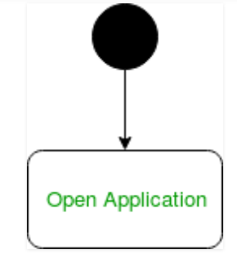
Initial State
For example – Here the initial state is the state of the system before the application is opened

Slide 10

Action or Activity State
An activity represents execution of an action on objects or by objects.
We represent an activity using a rectangle with rounded corners.
Basically any action or event that takes place is represented using an activity.
Is used to represent a set of actions
A task to be performed

Slide 11
Action Flow or Control flows
Shows the sequence of execution
Action flows or Control flows are also referred to as paths and edges.
They are used to show the transition from one activity state to another.

Slide 12
Action Flow or Control flows
An activity state can have multiple incoming and outgoing action flows.
We use a line with an arrow head to depict a Control Flow.
If there is a constraint to be adhered to while making the transition it is mentioned on the arrow.

Slide 13
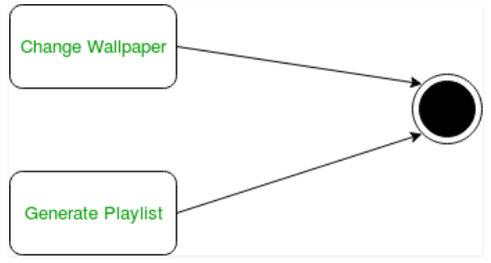
Action Flow or Control flows
Consider the example – Here both the states transit into one final state using action flow symbols i.e. arrows.

Slide 14

Decision node and Branching
When we need to make a decision before deciding the flow of control, we use the decision node.
The outgoing arrows from the decision node can be labeled with conditions or guard expressions.
It always includes two or more output arrows.

Slide 15
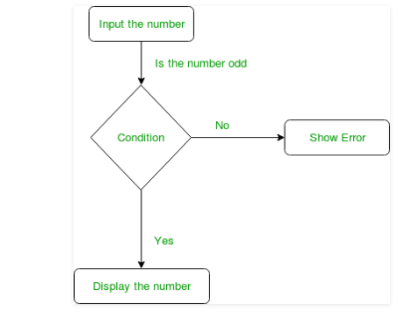
Decision node and Branching

Slide 16
Guards
A Guard refers to a statement written next to a decision node on an arrow sometimes within square brackets.
The statement must be true for the control to shift along a particular direction.
Guards help us know the constraints and conditions which determine the flow of a process.

Slide 17
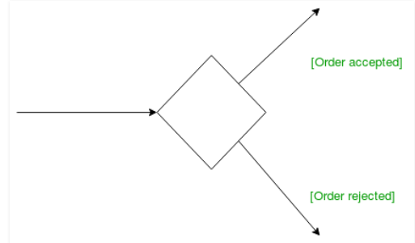
Guards

Slide 18
Fork
Fork nodes are used to support concurrent activities.
We use a fork node when both the activities get executed concurrently i.e. no decision is made before splitting the activity into two parts.
Both parts need to be executed in case of a fork statement
We use a rounded solid rectangular bar to represent a Fork notation with incoming arrow from the parent activity state and outgoing arrows towards the newly created activities.

Slide 19
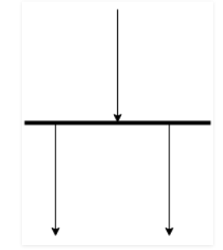
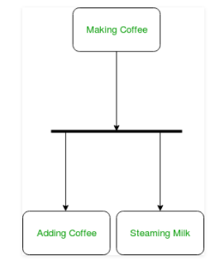
Fork
For example: In the example below, the activity of making coffee can be split into two concurrent activities and hence we use the fork notation.

Slide 20
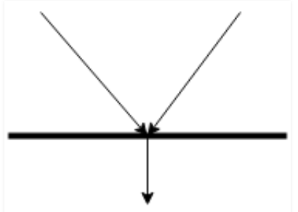
Join
Join nodes are used to support concurrent activities converging into one. For join notations we have two or more incoming edges and one outgoing edge.
Bring back together a set of parallel or concurrent flows of activities (or actions).

Slide 21
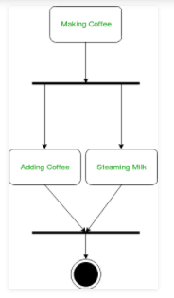
Join
For example – When both activities i.e. steaming the milk and adding coffee get completed, we converge them into one final activity.

Slide 22
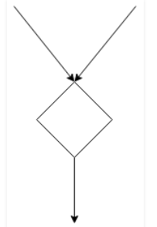

Merge or Merge Event
Scenarios arise when activities which are not being executed concurrently have to be merged. We use the merge notation for such scenarios.
We can merge two or more activities into one if the control proceeds onto the next activity irrespective of the path chosen.

Slide 23
Merge or Merge Event
For example – In the diagram below: we can’t have both sides executing concurrently, but they finally merge into one. A number can’t be both odd and even at the same time.

Slide 24
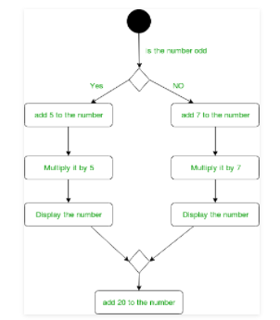
Merge or Merge Event

Slide 25

Final State or End State
The state which the system reaches when a particular process or activity ends is known as a Final State or End State.
We use a filled circle within a circle notation to represent the final state in a state machine diagram.
Stop all control flows and object flows in an activity (or action)

Slide 26
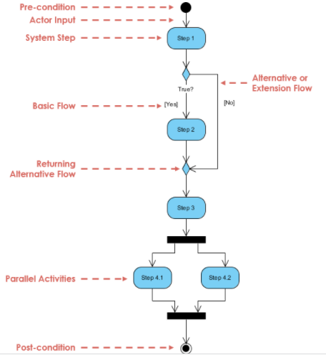
Example

Slide 27
Activity Diagram Example - Student Enrollment
This UML activity diagram example describes a process for student enrollment in a university as follows:
An applicant wants to enroll in the university.
The applicant hands a filled out copy of Enrollment Form.
The registrar inspects the forms.
The registrar determines that the forms have been filled out properly.
The registrar informs student to attend in university overview presentation.
The registrar helps the student to enroll in seminars
The registrar asks the student to pay for the initial tuition.

Slide 28
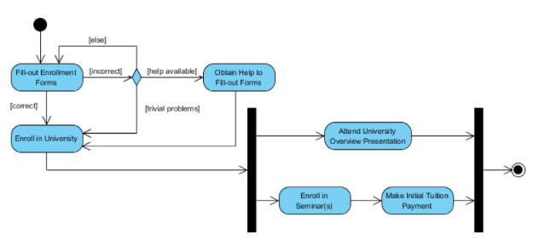
Activity Diagram Example - Student Enrollment

Slide 29
Activity Diagram Example - Process Order
Given the problem description related to the workflow for processing an order, let's model the description in visual representation using an activity diagram:
Process Order - Problem Description
Once the order is received, the activities split into two parallel sets of activities. One side fills and sends the order while the other handles the billing.
On the Fill Order side, the method of delivery is decided conditionally. Depending on the condition either the Overnight Delivery activity or the Regular Delivery activity is performed.
Finally the parallel activities combine to close the order.

Slide 30
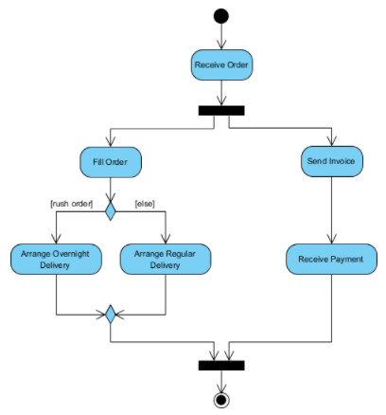
The activity diagram example below visualize the flow in graphical form.

Slide 31
